Slide 1



Slide 2
Contents of this template
What is the SOLID Design Principles
Single Responsibility Principle
Open-Closed Principle
4. Liskov Substitution Principle
5. Interface Segregation Principle
6. Dependency Inversion Principle

Slide 3
What is the SOLID Design Principles

Slide 4
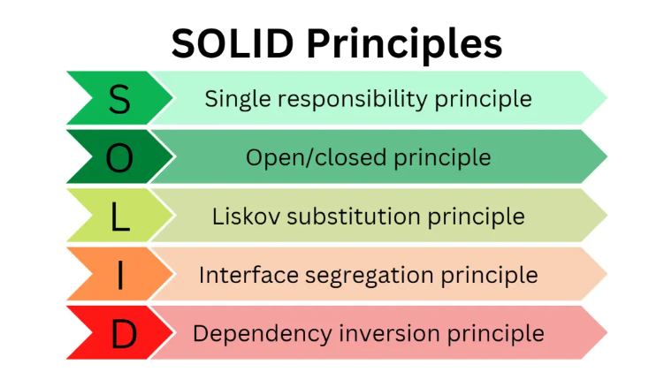
SOLID is a popular set of design principles that are used in object-oriented software development. SOLID is an acronym that stands for five key design principles: single responsibility principle, open-closed principle, Liskov substitution principle, interface segregation principle, and dependency inversion principle. All five are commonly used by software engineers and provide some important benefits for developers.

Slide 5
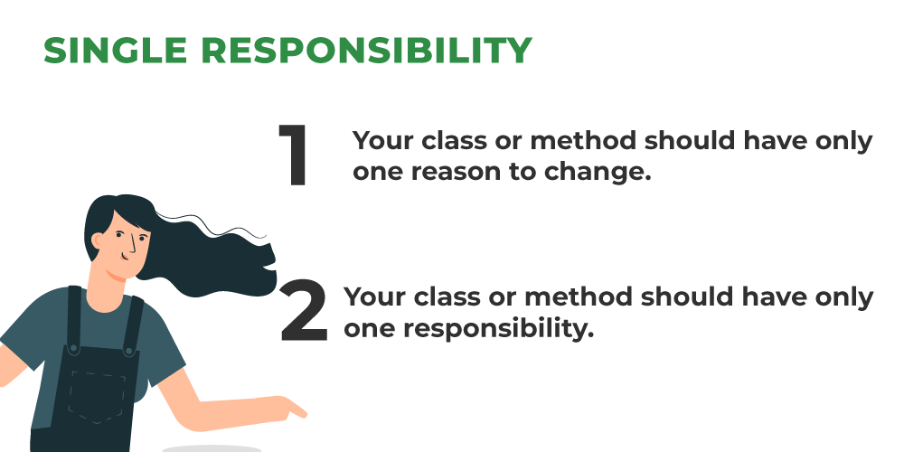
Single Responsibility Principle
Robert Martin summarizes this principle well by mandating that, “a class should have one, and only one, reason to change.” Following this principle means that each class only does one thing and every class or module only has responsibility for one part of the software’s functionality. More simply, each class should solve only one problem.

Slide 6
Open-Closed Principle
The idea of open-closed principle is that existing, well-tested classes will need to be modified when something needs to be added. Yet, changing classes can lead to problems or bugs. Instead of changing the class, you simply want to extend it. With that goal in mind, Martin summarizes this principle, “You should be able to extend a class’s behavior without modifying it.”
Following this principle is essential for writing code that is easy to maintain and revise. Your class complies with this principle if it is:
1 . Open for extension, meaning that the class’s behavior can be extended;
2 . Closed for modification, meaning that the source code is set and cannot be changed.

Slide 7
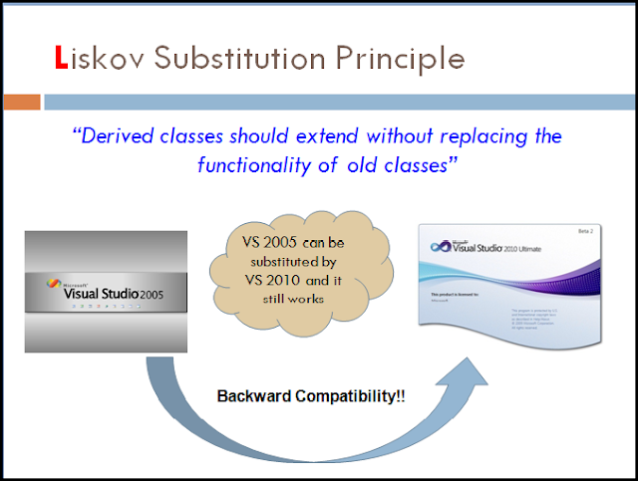
Liskov Substitution Principle
Of the five SOLID principles, the Liskov Substitution Principle is perhaps the most difficult one to understand. Broadly, this principle simply requires that every derived class should be substitutable for its parent class. The principle is named for Barbara Liskov, who introduced this concept of behavioral subtyping in 1987. Liskov herself explains the principle by saying:

Slide 8
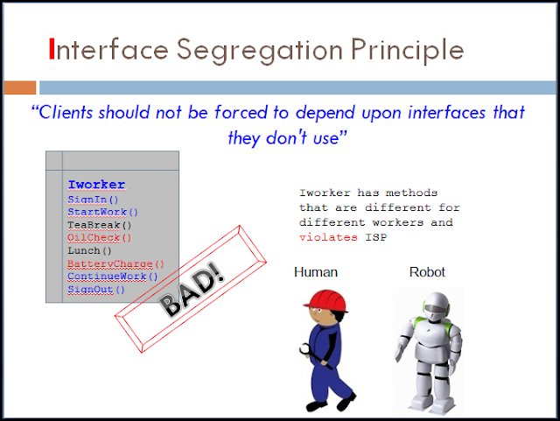
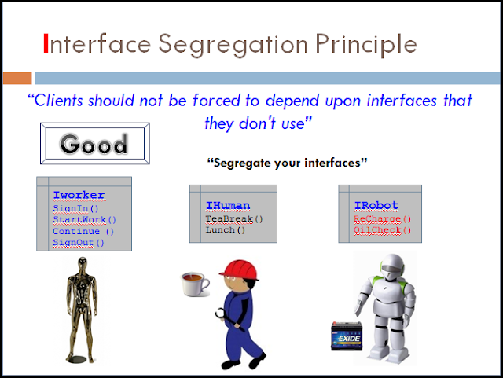
Interface Segregation Principle
The general idea of interface segregation principle is that it’s better to have a lot of smaller interfaces than a few bigger ones. Martin explains this principle by advising, “Make fine grained interfaces that are client-specific. Clients should not be forced to implement interfaces they do not use.”
For software engineers, this means that you don’t want to just start with an existing interface and add new methods. Instead, start by building a new interface and then let your class implement multiple interfaces as needed.

Slide 9
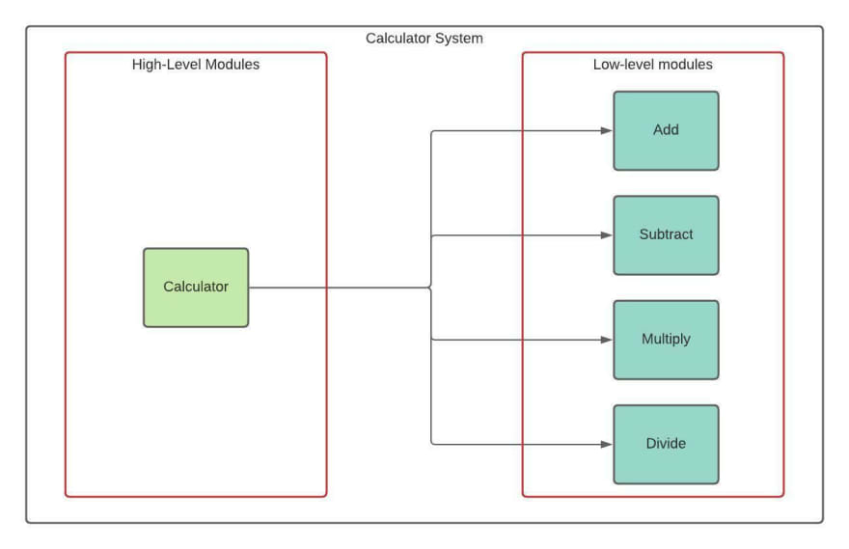
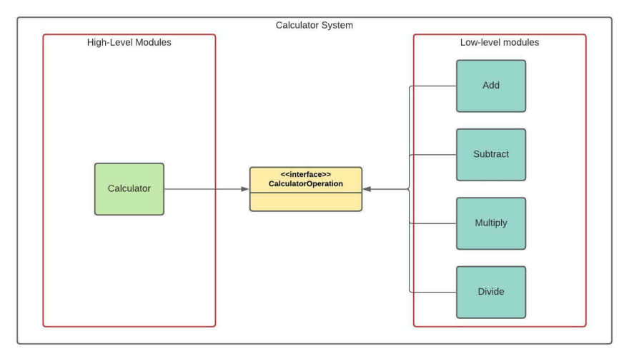
Dependency Inversion Principle
This principle offers a way to decouple software modules. Simply put, dependency inversion principle means that developers should “depend on abstractions, not on concretions.” Martin further explains this principle by asserting that, “high level modules should not depend upon low level modules. Both should depend on abstractions.” Further, “abstractions should not depend on details. Details should depend upon abstractions.”
FALSE
TRUE

Slide 10
What is a design pattern?

Slide 11
A design pattern in C# is a reusable solution to a commonly occurring problem in software development that provides a blueprint for designing and implementing software systems.
It is a description of a set of interacting classes that provide a framework for a solution to a generalized problem in a specific context or environment.
Design patterns assist in laying the foundation for flexible architecture, which is the hallmark of every good object-oriented design.
Design patterns have been cataloged to address various design problems, from small to large issues and architecture-level problems.
Design patterns make good templates for your objects, allowing you to build software faster.
Design patterns are created to fix known problems, they can be predicted before they become visible during the implementation process.

Slide 12
Why use a design pattern?

Slide 13
Re-usability: Design patterns provide proven solutions to common software development problems. By using them, you can leverage existing solutions and best practices, saving time and effort in designing and implementing new software systems.
Maintainability: Design patterns help create code that is easier to maintain and update. They provide clear structures and guidelines for organizing code, making it easier to understand, modify, and extend in the future.
Efficiency: Design patterns can help optimize code and improve performance. They provide optimized solutions to common problems, reducing redundant code and improving the overall efficiency of the software system.

Slide 14
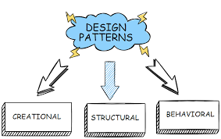
Types of Design Patterns
Creational Design Patterns
The basic mode of forming an object may be problematic in some projects and may lead to unnecessary complexity in some areas. Creational patterns are supposed to prevent problems from occurring and introduce more control over creating objects.
Behavioural Patterns
Behavioral patterns task is to introduce flexibility to solutions connected with inter-object communication, managing relationships, and responsibilities between objects. They are focused on allocating specific roles and duties between objects in communication.
Structural patterns
Structural design patterns are design patterns that focus on the composition of classes and objects to form larger structures while keeping the individual components of the structure flexible and interchangeable.

Slide 15
Thanks For Whatching

